Slide 1
HTML Links
ZhuHua

Slide 2
Links
Links are the defining feature of the web because they allow you to move from one web page to another — enabling the very idea of browsing or surfing
Links from one website to another
Links from one page to another on the same website
Links from one part of a web page to another part of the same page
Links that open in a new browser window
Links that start up your email program and address a new email to someone

Slide 3
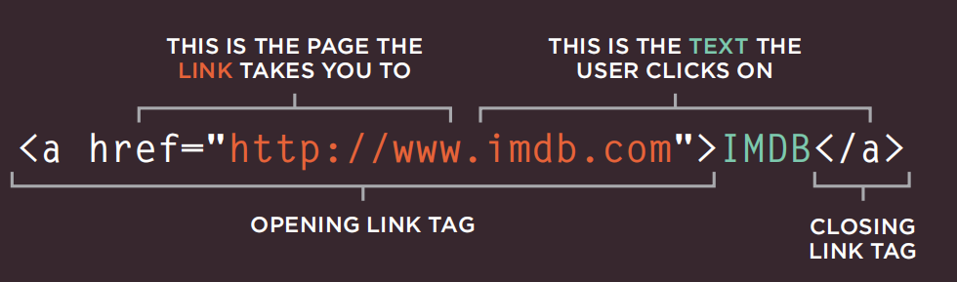
Writing Links
Links are created using the <a> element. Users can click on anything between the opening <a> tag and the closing </a> tag. You specify which page you want to link to using the href attribute.

Slide 4
Linking to Other Sites
Links are created using the <a> element which has an attribute called href. The value of the href attribute is the page that you want people to go to when they click on the link.
Users can click on anything that appears between the opening <a> tag and the closing </a> tag and will be taken to the page specified in the href attribute.
When you link to a different website, the value of the href attribute will be the full web address for the site, which is known as an absolute URL.
<a href="https://www.baidu.com/">baidu</a>

Slide 5
Linking to Other Pages on the Same Site
When you are linking to other pages within the same site, you do not need to specify the domain name in the URL.
You can use a shorthand known as a relative URL. If all the pages of the site are in the same folder, then the value of the href attribute is just the name of the file.

Slide 6
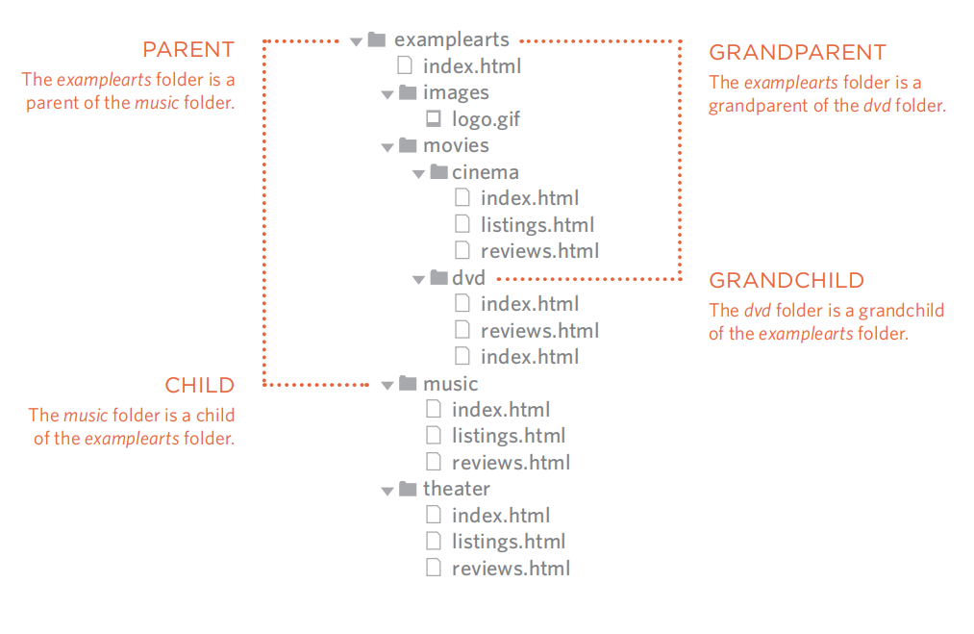
Directory Structure

Slide 7
Relative URLs
Same Folder To link to a file in the same folder, just use the file name.
<a href="reviews.html">Reviews</a>
Child Folder For a child folder, use the name of the child folder, followed by a forward slash, then the file name. <a href="music/listings.html">Listings</a>
Grandchild Folder Use the name of the child folder, followed by a forward slash, then the name of the grandchild folder, followed by another forward slash, then the file name. <a ref="movies/dvd/reviews.html">Reviews</a>
Parent Folder Use ../ to indicate the folder above the current one, then follow it with the file name. <a href="../index.html">Home</a>
GrandParent Folder Repeat the ../ to indicate that you want to go up two folders (rather than one), then follow it with the file name. <a href="../../index.html">Home</a>

Slide 8
Questions？
Which of the following code snippets correctly creates a hyperlink to the website "https://www.google.com" with the clickable text "Go to Google"?
A) <a src="https://www.google.com">Go to Google</a>
B) <link href="https://www.google.com">Go to Google</link>
C) <a href="https://www.google.com">Go to Google</a>
D) <a link="https://www.google.com">Go to Google</a>

Slide 9
Questions？
Which of the following code snippets correctly creates a hyperlink to the website "https://www.google.com" with the clickable text "Go to Google"?
A) <a src="https://www.google.com">Go to Google</a>
B) <link href="https://www.google.com">Go to Google</link>
C) <a href="https://www.google.com">Go to Google</a>
D) <a link="https://www.google.com">Go to Google</a>

Slide 10
Email Links
To create a link that starts up the user's email program and addresses an email to a specified email address, you use the <a> element. However, this time the value of the href attribute starts with mailto: and is followed by the email address you want the email to be sent to
<a href="mailto:jon@example.org">Email Jon</a>

Slide 11
Opening Links in a New Window
If you want a link to open in a new window, you can use the target attribute on the opening <a> tag. The value of this attribute should be _blank
<a href="http://www.imdb.com" target="_blank"> Internet Movie Database</a> (opens in new window)

Slide 12
Linking to a Specific Part of the Same Page
Before you can link to a specific part of a page, you need to identify the points in the page that the link will go to. You do this using the id attribute (which can be used on every HTML element).
You can see that the <h1> and <h2> elements in this example have been given id attributes that identify those sections of the page. The value of the id attribute should start with a letter or an underscore (not a number or any other character) and, on a single page, no two id attributes should have the same value
To link to an element that uses an id attribute you use the <a> element again, but the value of the href attribute starts with the # symbol, followed by the value of the id attribute of the element you want to link to. In this example, <a href="#top"> links to the <h1> element at the top of the page whose id attribute has a value of top.

Slide 13
Linking to a Specific Part of Another Page
As long as the page you are linking to has id attributes that identify specific parts of the page, you can simply add the same syntax to the end of the link for that page.
Therefore, the href attribute will contain the address for the page (either an absolute URL or a relative URL), followed by the # symbol, followed by the value of the id attribute that is used on the element you are linking to.
For example, to link to the bottom of the homepage of the website that accompanies this book, you would write: <a href="https:/www. baidu.com/ #top">

Slide 14
Summary
Links are created using the <a> element.
The <a> element uses the href attribute to indicate the page you are linking to.
If you are linking to a page within your own site, it is best to use relative links rather than qualified URLs.
You can create links to open email programs with an email address in the "to" field.
You can use the id attribute to target elements within a page that can be linked to.

Slide 15
Questions？
You want a hyperlink to open in a new browser tab when a user clicks on it. Which attribute and value should you add to the <a> tag to achieve this?
A) target="_blank"
B) target="_new"
C) open="new_tab"
D) link="_blank"

Slide 16
Questions？
You want a hyperlink to open in a new browser tab when a user clicks on it. Which attribute and value should you add to the <a> tag to achieve this?
A) target="_blank"
B) target="_new"
C) open="new_tab"
D) link="_blank"

